Slide 1
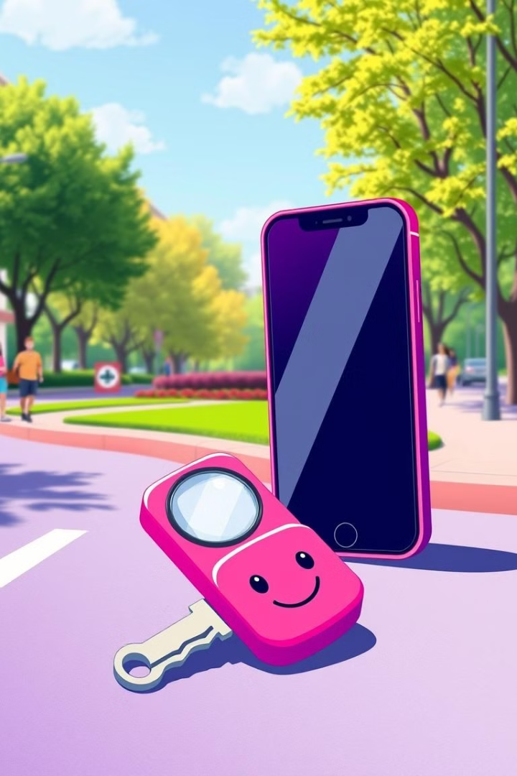

Just Found: Lost & Found Simply
Imagine a world where lost items are easily recovered.

Slide 2

A Problem We All Face
1
Lost & Found Frustration
2
Traditional Methods Fail
Everyone has experienced the stress of losing something.
Current recovery methods are inefficient and outdated.
3
Our Solution Streamlines
Just Found makes recovery quick and easy.

Slide 3
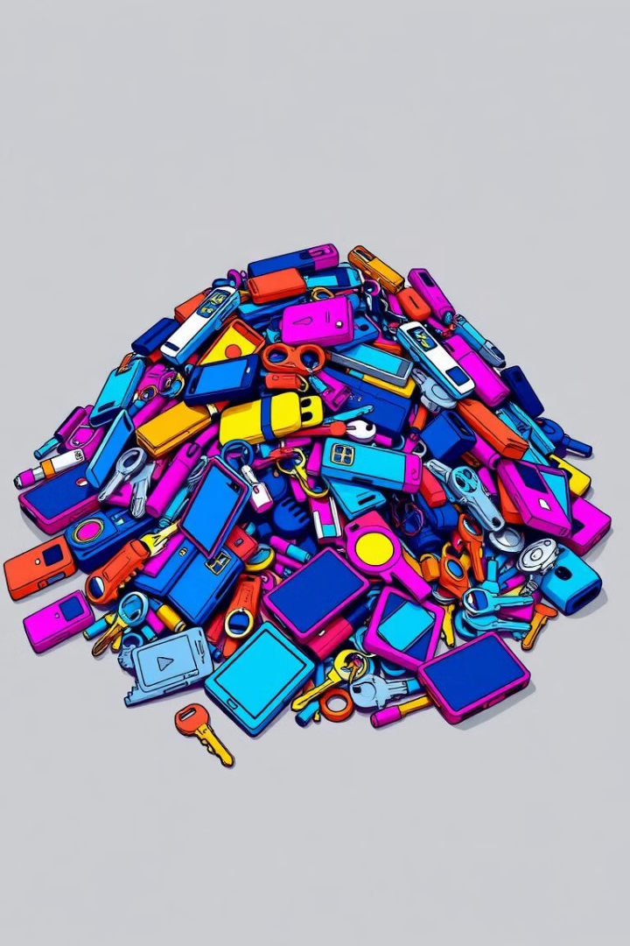
The Impact of Lost Items
Millions lost annually
Low recovery rates
Environmental waste
Stress & inconvenience
Outdated systems
Community frustration

Slide 4
Transforming Lost & Found
Centralized Platform
Community Engagement
Law Enforcement Integration
Increases recovery chances by connecting people.
Encourages collaboration and helpfulness.
Adds security and ensures safe recovery.

Slide 5
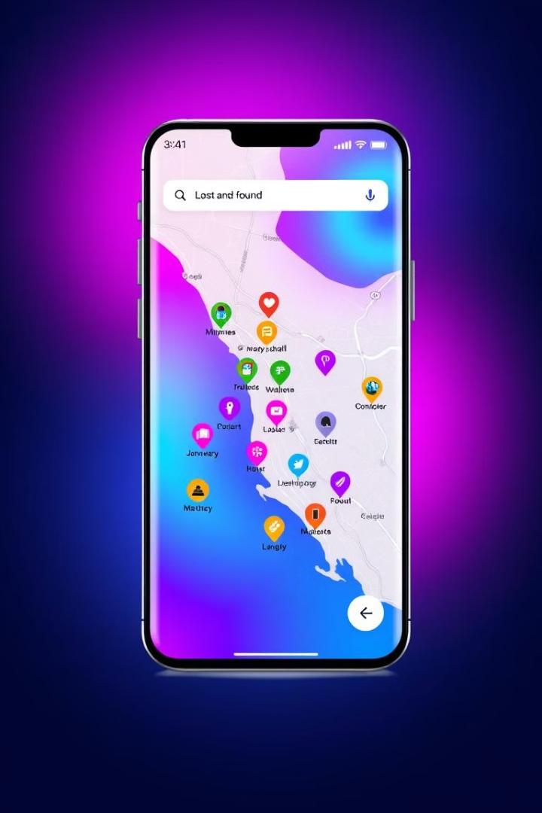
Key Features of Just Found
User-Friendly Reporting
AI-Powered Identification
Easy to report lost or found items.
Generate detailed descriptions for quick matching.
Local Police Notifications
Searchable Database
Easy to find lost or found items.
Alert authorities to lost or found items.

Slide 6
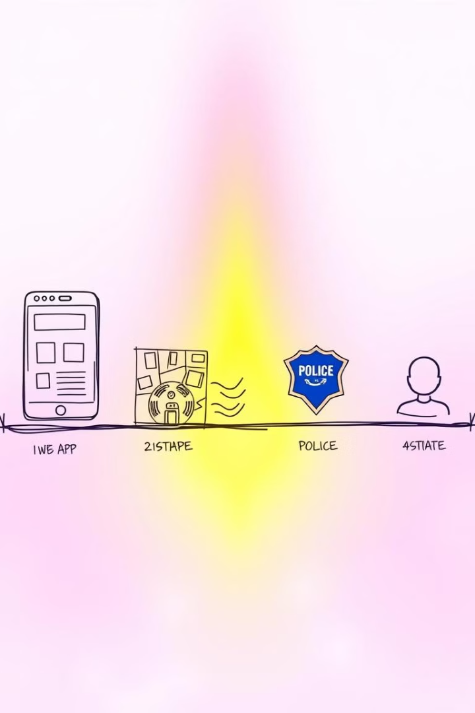
Implementation Roadmap
1
Web Platform Development
Create an intuitive and user-friendly platform.
2
Partnerships with Police
Collaborate with local authorities for safety.
3
Community Outreach
Spread awareness and encourage participation.
4
Continuous Improvement
Gather feedback for ongoing development.

Slide 7




Why It Matters
Accessible for All
Simple and easy to use for everyone.
Empowering Community
Individuals can help their community.
Positive Environmental Impact
Reduces waste by reclaiming lost items.

Slide 8




Join the Just Found Revolution
Contribute Ideas
Share your thoughts and feedback.
Spread the Word
Tell everyone about Just Found.
Work Together
Make a difference in your community.

